Slide 1
Stock Requisitions

Slide 2
Log into your Escape account using your Username and Password

Slide 3
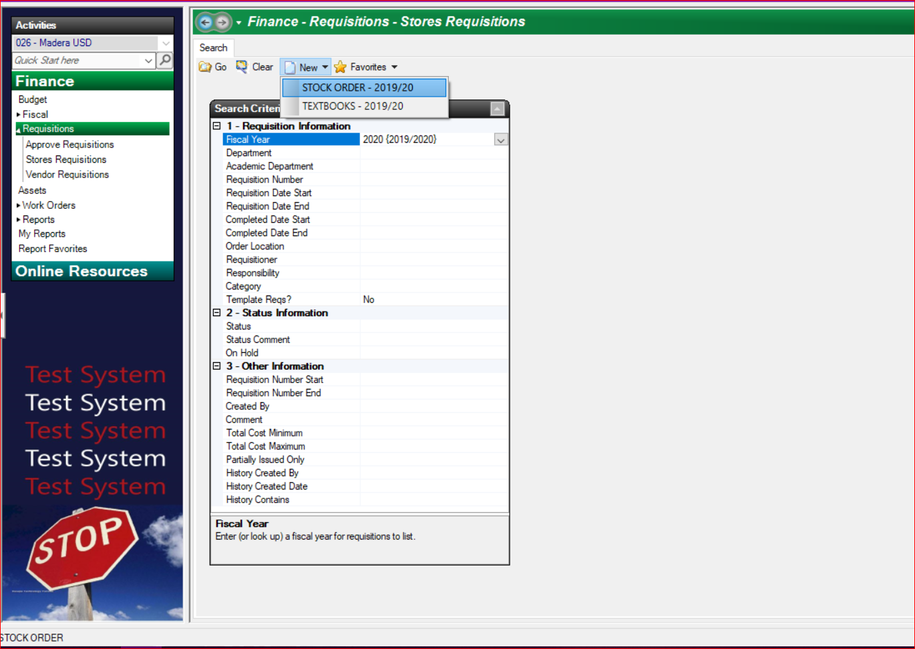
Click on Finance to open the activity tree.
Click on Requisitions, then Stores Requisitions
Click New and select either Stock Order or Textbooks

Slide 4
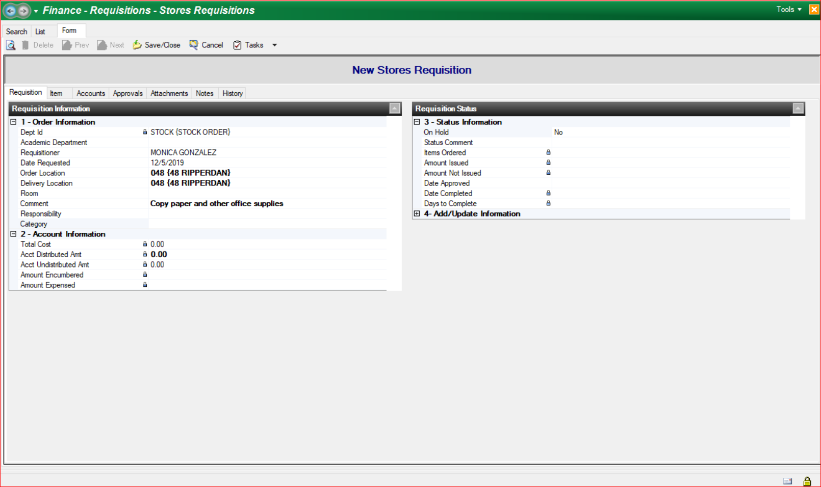
The Order Location and Delivery Location fields should already be filled in with your site’s information.
Use the enter key to move down to the Comment section and enter a brief description of what is being ordered. This is a required field
The Room and Responsibility fields are not required but you may include this information for your own use.
Click on the Item tab.

Slide 5
Click New.
If you know the stock number for the item(s) you are ordering, enter it in the Stores Item # field and press the Enter key on your keyboard.
Fill in the Order Quantity field.

Slide 6
If you do not know the stock item # you can enter a zero (0) or a word/letter followed and preceded by “%” then click on the drop down box arrow.
Choose your item from the dialog box that opens and fill in the Order Quantity field.
Fill in the Order Quantity field.

Slide 7
If you have additional items to order, click Save/New.
If you have no more items to add to your order click Save/Close
Click on the Accounts tab.

Slide 8
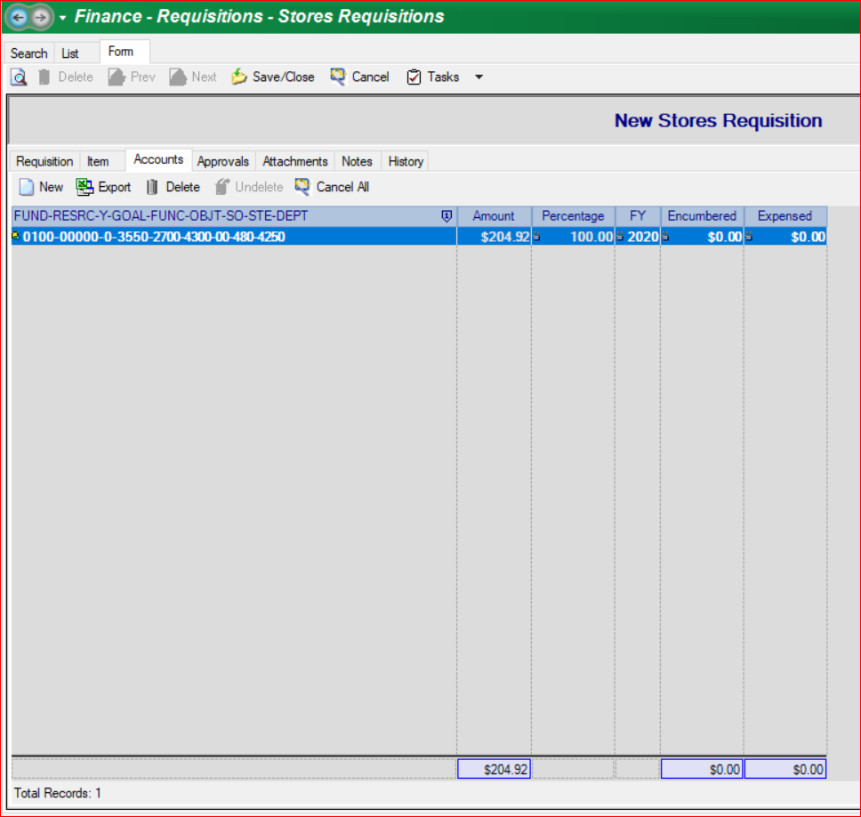
Click New
Enter your account #

Slide 9
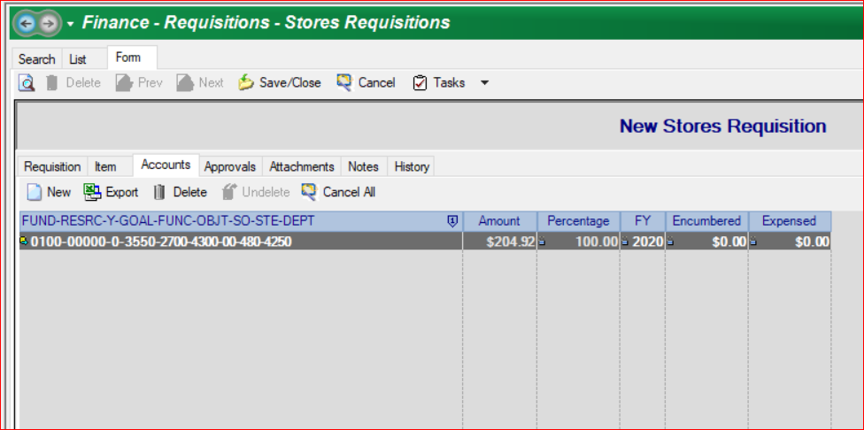
If you are unable to finish your requisition, you can click Save/Close then come back to it later to finish and submit your order.
If you are ready to submit your Stores Requisition Click on the Tasks drop-down menu and select Submit.

Slide 10
DONE!
Your order has been submitted to the Warehouse to fill.

